Slide 1

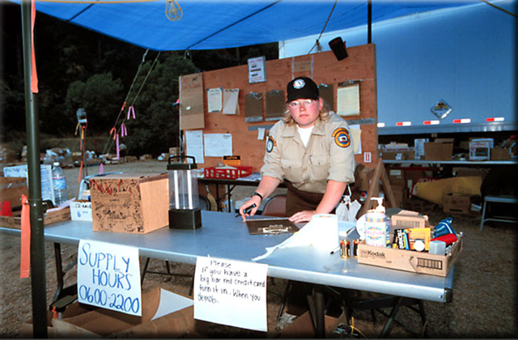
CREATING RESOURCE REQUESTs, PENDING REQUESTS, RESOURCE STATUS, AND EDIT REQUEST
Unit 4
D-110 Unit 4: Creating Resource Req/Pending Req/Resource Status/Edit Req

Slide 2
Objectives
Complete resource orders for overhead, crew and equipment requests from general message forms using the electronic resource tracking system (IROC)
Describe the use of the “Pending Request” screen.
Describe the use of the “Resource Status” screen.
Demonstrate the ability to utilize the “Edit Request” functionality.
D-110 Unit 4: Creating Resource Req/Pending Req/Resource Status/Edit Req
04-1-D110-EP

Slide 3
Source of Resource Request
From Initial Attack (IA)
From Incident
ORDM
By Telephone, Fax, General Message,
Email, Radio
D-110 Unit 4: Creating Resource Req/Pending Req/Resource Status/Edit Req
04-2-D110-EP

Slide 4
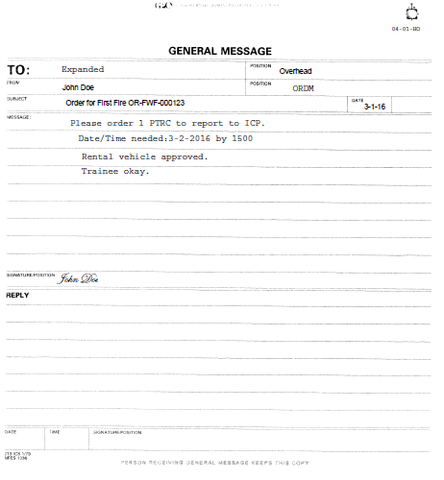
General Message
D-110 Unit 4: Creating Resource Req/Pending Req/Resource Status/Edit Req
04-3-D110-EP
Notes:
Make sure this matches Handout 4-1

Slide 5

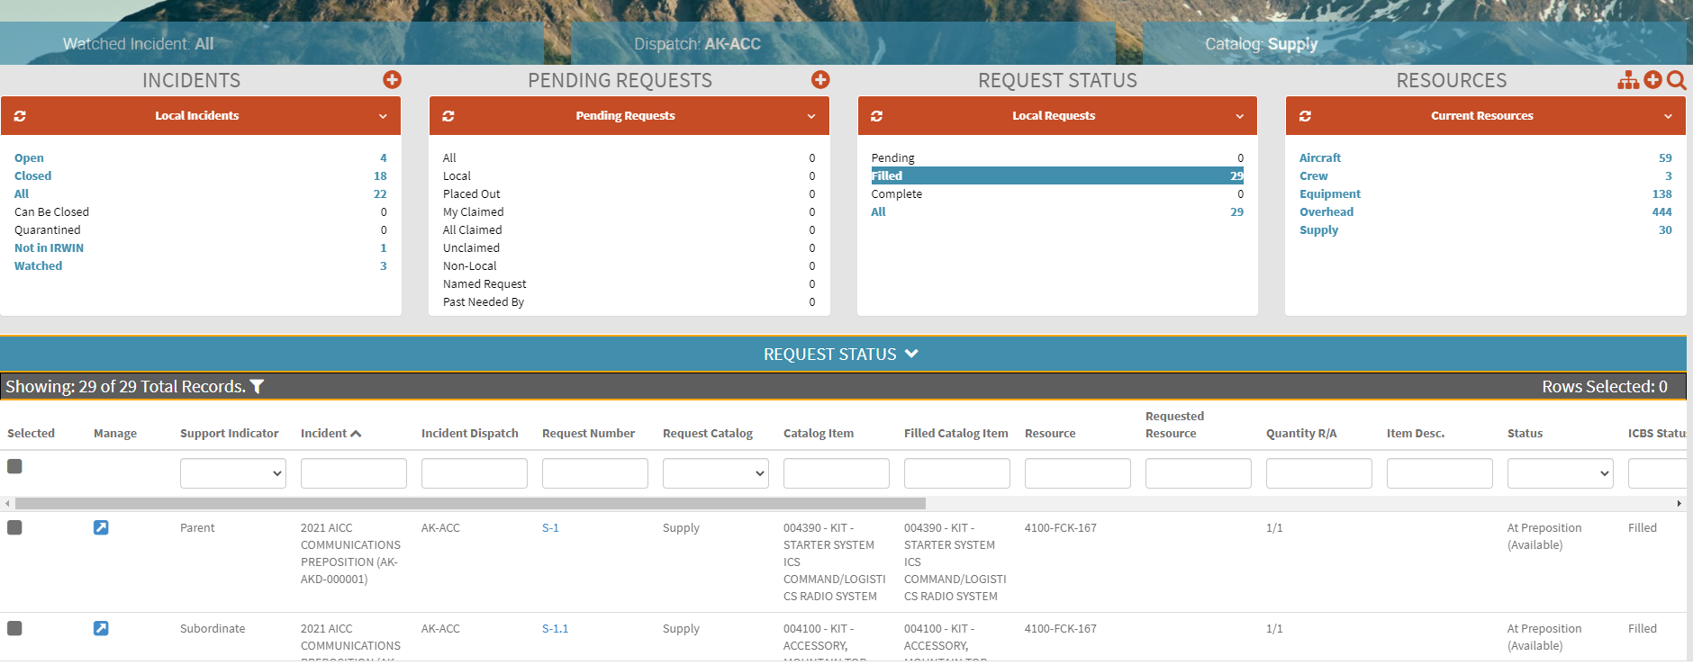
Content Selectors, Action Tiles and Main Work Area
D-110 Unit 4: Creating Resource Req/Pending Req/Resource Status/Edit Req
04-4-D110-EP

Slide 6
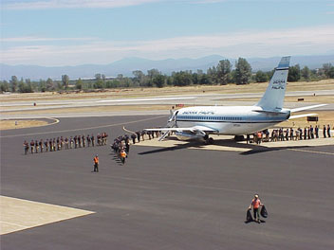

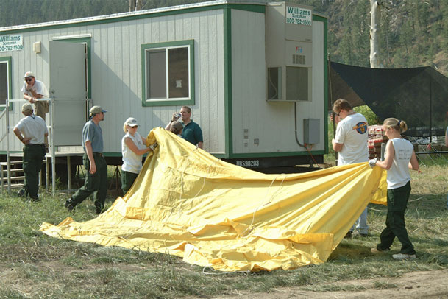
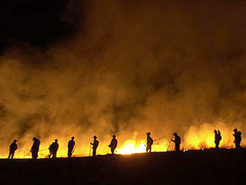
Resource Items
Overhead
Crews
D-110 Unit 4: Creating Resource Req/Pending Req/Resource Status/Edit Req
04-5-D110-EP

Slide 7
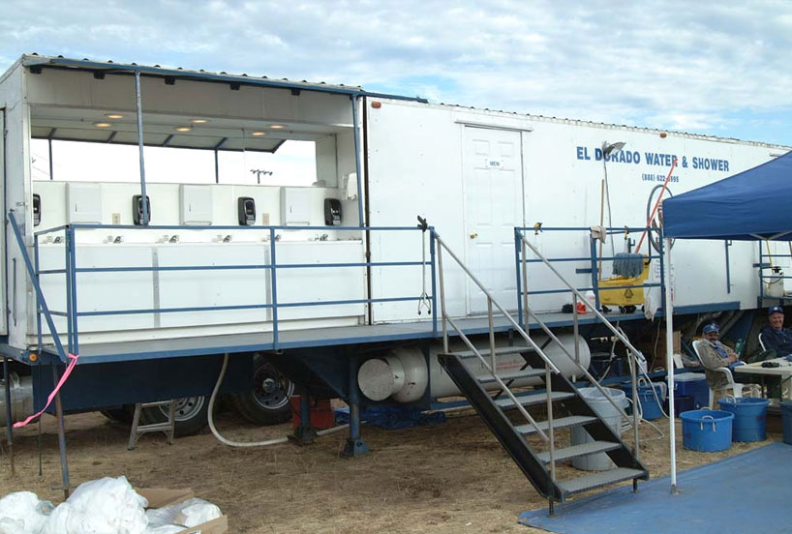
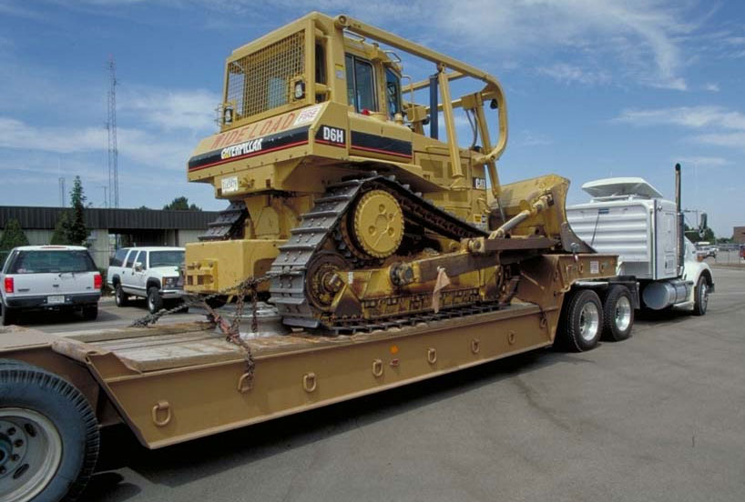
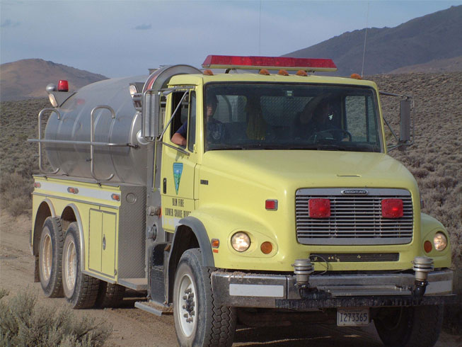
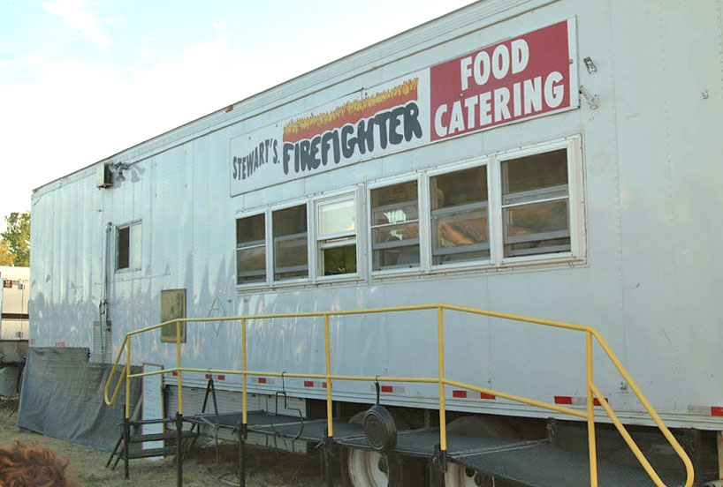
Resource Items
Equipment
D-110 Unit 4: Creating Resource Req/Pending Req/Resource Status/Edit Req
04-6-D110-EP

Slide 8
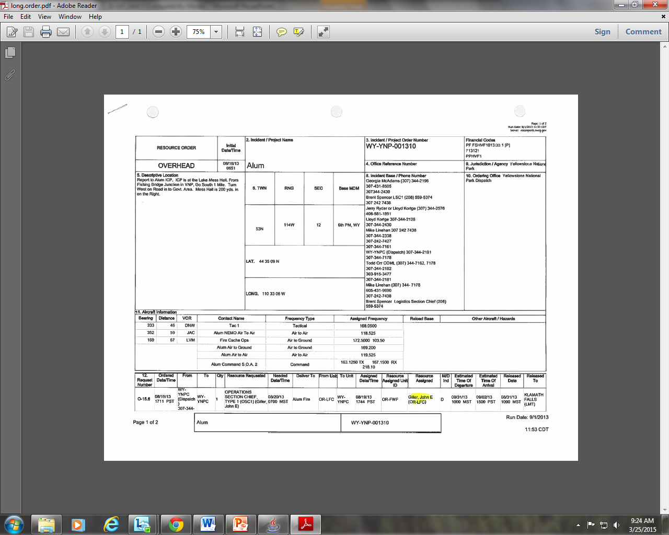
Too Many Contacts
D-110 Unit 4: Creating Resource Req/Pending Req/Resource Status/Edit Req
04-7-D110-EP

Slide 9
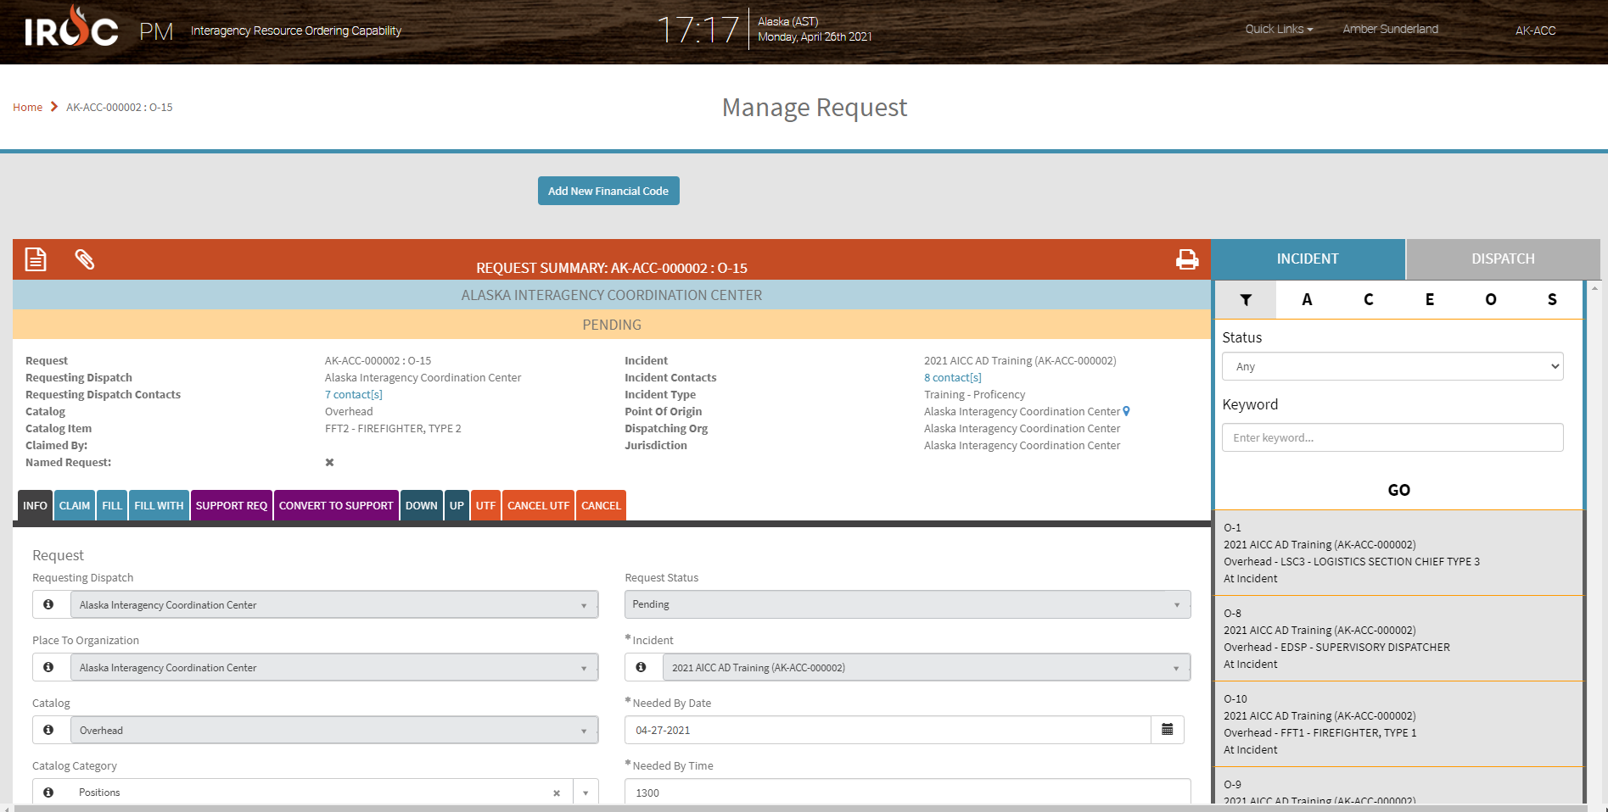
Manage Request Screen
D-110 Unit 4: Creating Resource Req/Pending Req/Resource Status/Edit Req
04-8-D110-EP

Slide 10
Objectives
Complete resource orders for overhead, crew and equipment requests from general message forms using the electronic resource tracking system (IROC)
Describe the use of the “Pending Request” screen.
Describe the use of the “Resource Status” screen.
Demonstrate the ability to utilize the “Edit Request” functionality.
D-110 Unit 4: Creating Resource Req/Pending Req/Resource Status/Edit Req
04-9-D110-EP

